Slide 1



ROCKBUSTER STEALTH
Business Strategy Plan
Schay Esparza

Slide 2




Objective
Launch Rockbuster Stealth's new business strategy for their new online video service.
Agenda
Key Questions
Movie Data Overview
Key Question Insights
Recommendations

Slide 3

Key Questions
Which movies contributed the most/least to revenue gain?
What was the average rental duration for all videos?
Which countries are Rockbuster customers based in?
Where are customers with a high lifetime value based?
Do sales figures vary between geographic regions?

Slide 4



MOVIE DATA OVERVIEW
Rental Duration
Movie Length
MINIMUM: 3 days
MAXIMUM: 7 days
AVERAGE: 5 days
MINIMUM: 46 minutes
MAXIMUM:185 minutes
AVERAGE: 115 minutes
Rental Rate
Replacement Cost
MINIMUM: $ 0.99
MAXIMUM:$ 4.99
AVERAGE: $ 2.98
MINIMUM: $ 9.99
MAXIMUM:$ 29.99
AVERAGE:$ 19.98

Slide 5

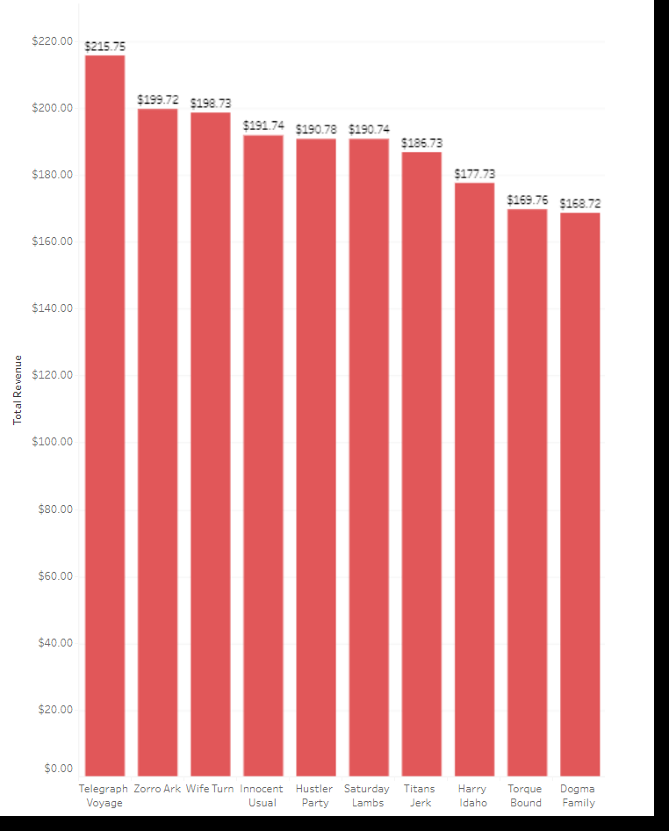
Which movies contributed the most to revenue gain?
TOP 10 MOVIES WITH HIGHEST REVENUE
The rental rate for all the movies mentioned is $4.99.
Movie that earned the highest revenue is "Telegraph Voyage" at $215.75.

Slide 6

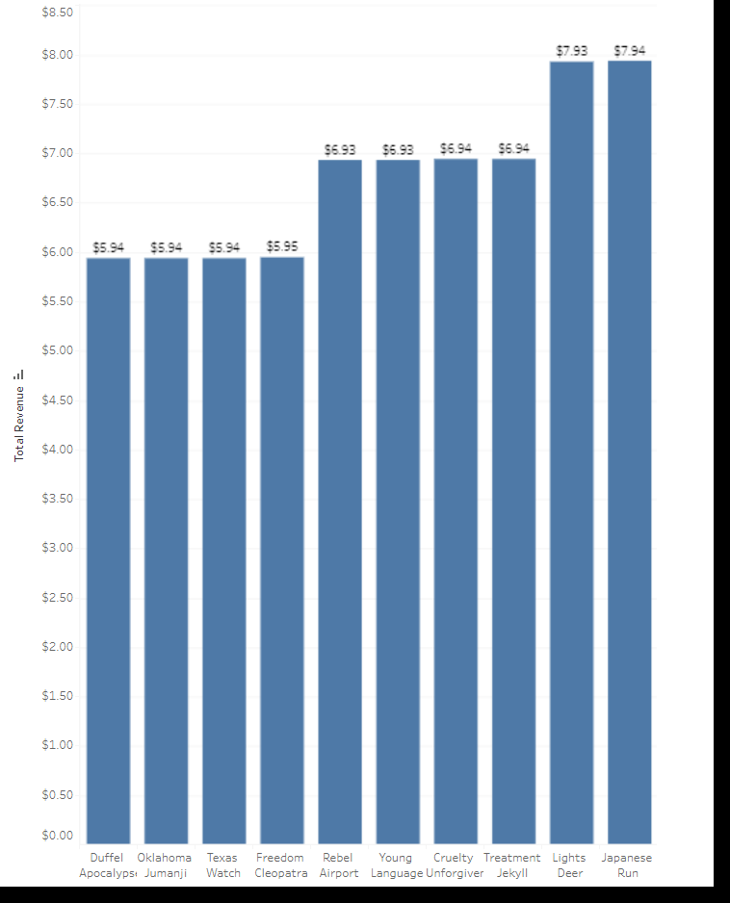
Which movies contributed the least to revenue gain?
BOTTOM 10 MOVIES WITH LOWEST REVENUE
Rental rate for all movies mentioned is $0.99
Movies that earned the least revenues are Duffel Apocalypse, Oklahoma Jumanji, Texas Watch and Freedom Cleopatra at $5.94 each.

Slide 7

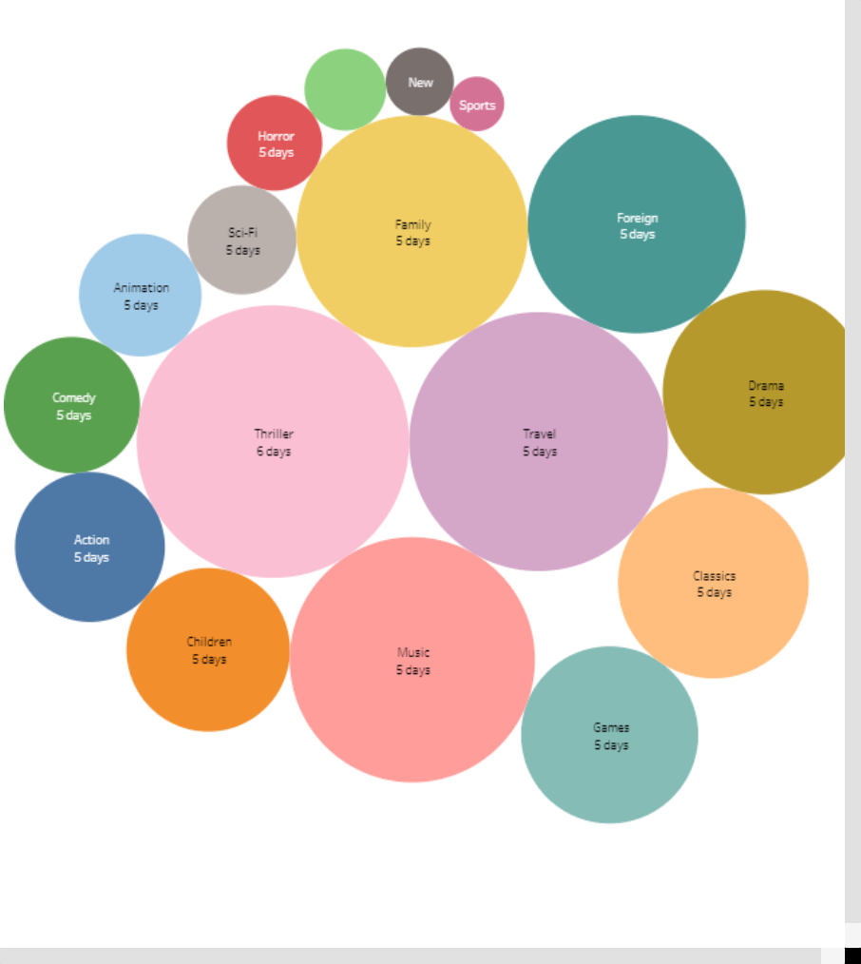
What was the average rental duration for all videos?
The longest average rental duration is 6 days for thriller.
Most movies are rented out for an average of 5 days.

Slide 8
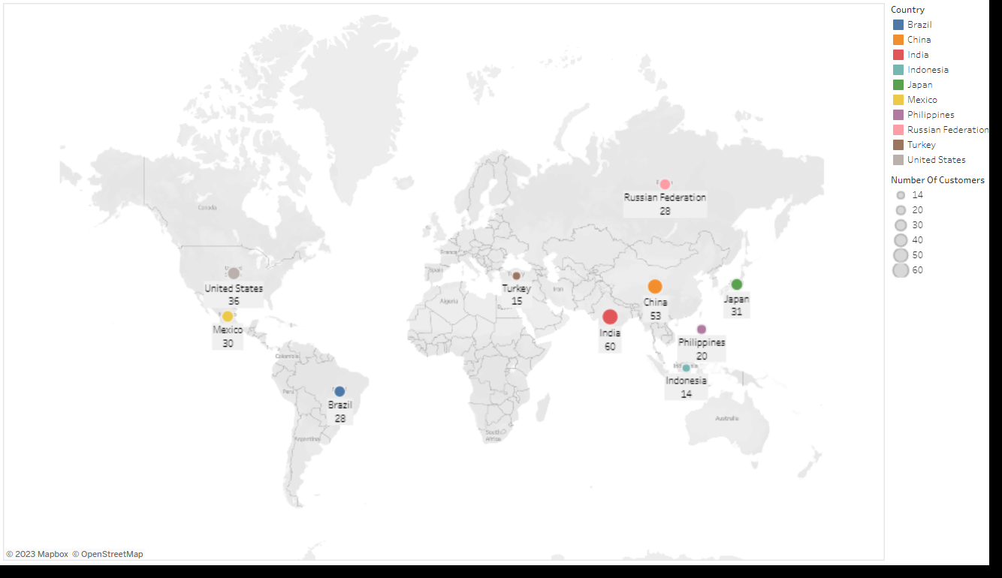
Which countries are Rockbuster customers based in?
TOP 10 CITIES IN TOP 10 COUNTRIES
Aurora, USA
Acua, Mexico
Citrus Heights, USA
Iwaki, Japan
Ambattur, India
Shanwei, China
So Leopoldo, Brazil
Tianjin , China
Hami, China
Cianjur, Indonesia

Slide 9
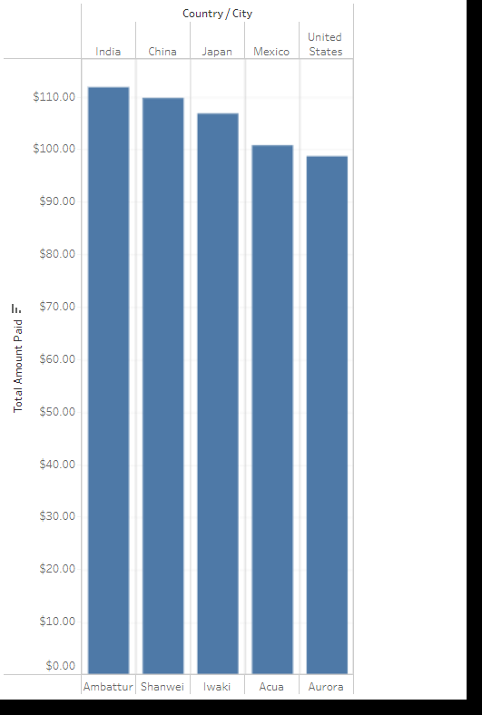
Where are customers with a high lifetime value based?
The top customers with a high lifetime value
based can be found in cities and countries included in the Top 10 cities and countries list.
The top 5 customers have a combined total of $527.77 lifetime value.
Their average lifetime value is $105.55
TOP 5 CUSTOMERS LOCATION

Slide 10
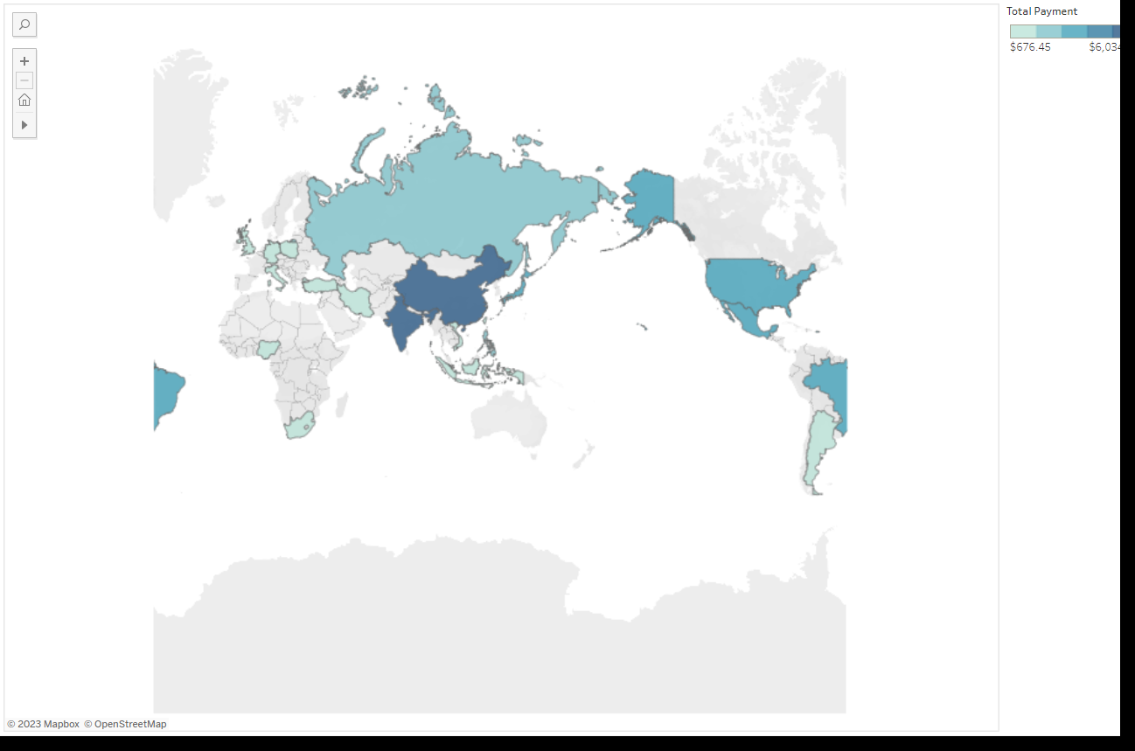
Do sales figures vary between geographic regions?
TOP 5 COUNTRIES WITH HIGHEST REVENUES.
India $6034.78
China $5251.03
United States $3685.31
Japan $3122.51
Mexico $2984.82
Sales figure does vary between geographic region.
Currently dominated by the Asian Market with 3 out of the top 5 slots being Asian countries.
TOP 20 COUNTRIES AND THEIR REVENUE

Slide 11
Recommendations
Target marketing efforts in countries with already a large customer base such as India, China and United States.
Create loyalty points system for customers to encourage more rentals by rewarding their membership.
Create a top 10 movie list to display the current most popular movies to boost promotion on those movies.
Eliminate low revenue movies.
Cater to the local market, add some local movies in the inventory for the different countries.

Slide 12
Thank You

